Slide 1


Dissociable neural reinstatement of emotional memories in human PFC
Augustin Hennings
Dunsmoor & Lewis-Peacock Labs
CLM retreat 12/3/19

Slide 2
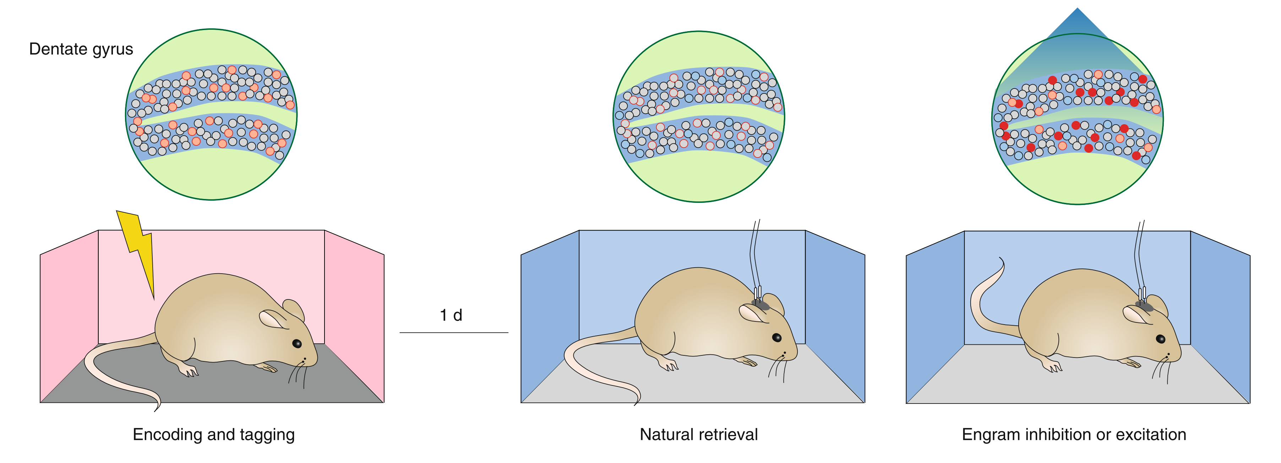
Specificity of neural coding
The neural circuits which encode a memory reactivate during retrieval
Fear and extinction engrams are stable and separable, in rodents
Engram manipulation leads to retrieval or blocking of associative memories
1
Dentate Gyrus
Optogenetic manipulation
Encoding and tagging
Retrieval test
Engram inhibition or excitation
Frankland et al., 2019 Nat. Neurosci.
Notes:
This is the idea of encoding specificity, first posited by Thompson & Tulving
Research into the learning of conditioned fear and extinction has been able to demonstrate this principle to great success in rodents – and we now know that fear and extinction memories exist as stable and separable engrams
Not only have these engrams been identified - they have also been manipulated and shown to have real consequences for behavior
This research has more than theoretical implicatons, if we can develop techniques to isolate
What is an engram – dissociable neural code

Slide 3
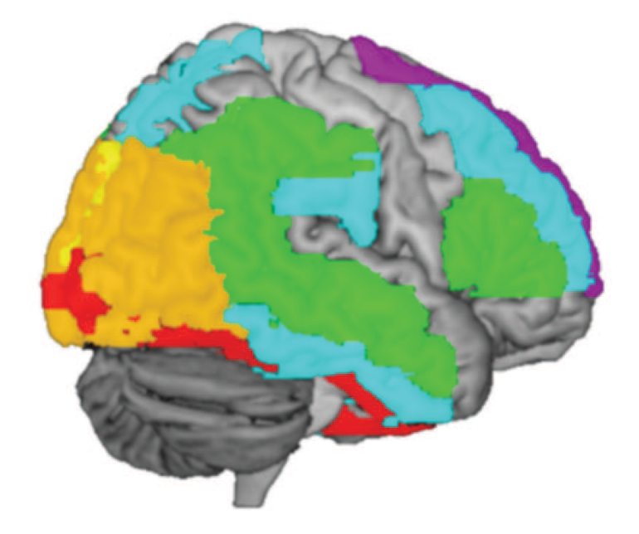
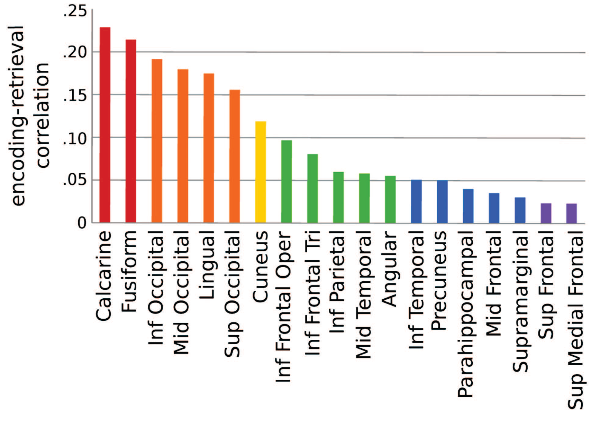
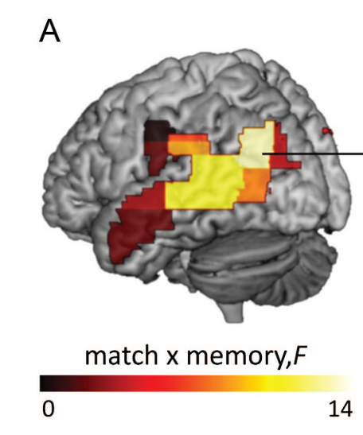
Reinstatement in the human brain
Encoding Retrieval Similarity (ERS)
Measure overlap of neural activity from encoding to retrieval
Neural circuits : spatial patterns of neural activity
The fidelity of memory reactivation influences behavior
Item-level reactivation in cortex
Item-level reactivation predicts memory
Ritchey et al., 2013. Cereb. Cortex
Notes:
Say this when for the first picture – this Provides evidence for neural reinstatement in humans
Be smarter introducing these figures – its real data
Cover A up

Slide 4
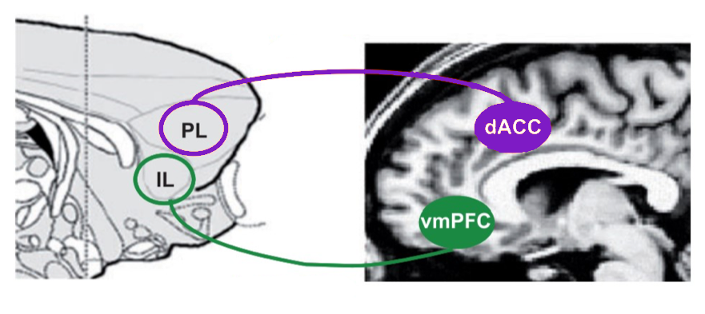


Dual role of PFC in emotional memory
Engram studies in rodents focus on the hippocampus (contextual fear conditioning)
Acquisition and retrieval of emotional memories involves the amygdala, hippocampus and PFC
Fear Acquisition
Prelimbic and infralimbic code for memories of opposite valence
PL = Fear Acquisition
IL = Extinction
Extinction
Milad & Quirk, 2012. Annu. Rev. Psychol.
Notes:
Engram studies in rodents focus mainly on the hippocampus, as the specific flavor of classical conditioning used is context conditioning.
We know that learning of both threat and safety depend on a circuit that includes the amygdala, hippocampus and the pre-frontal cortex.
Replace “more/less”
Label mouse and human (picture or word)

Slide 5
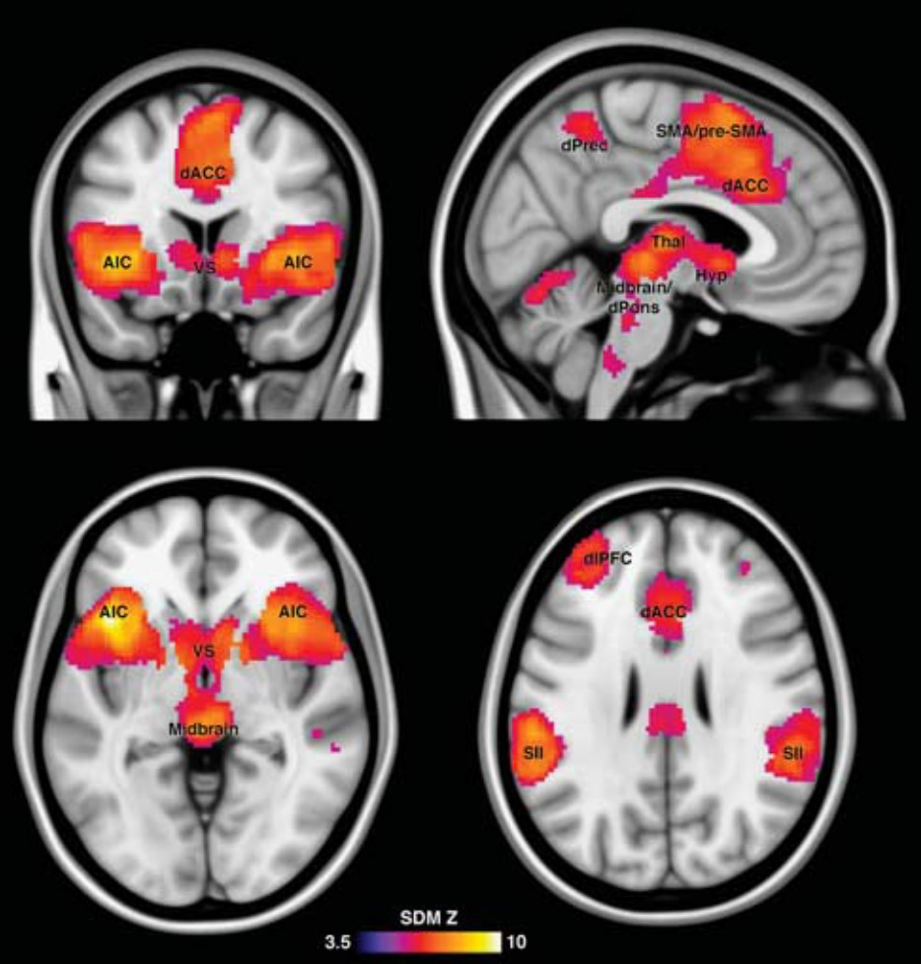
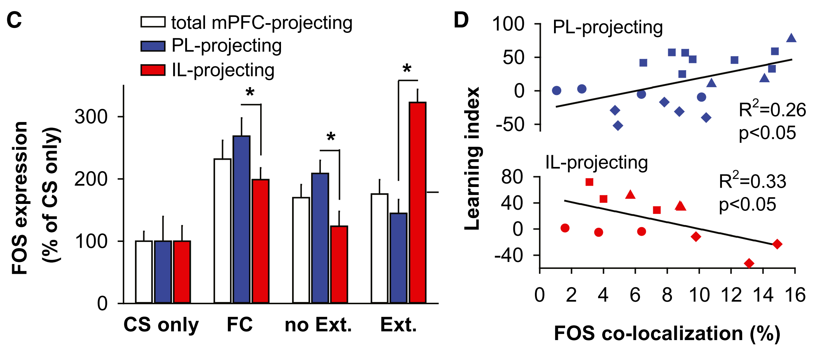
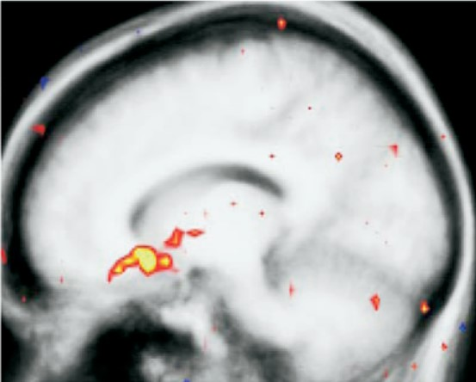
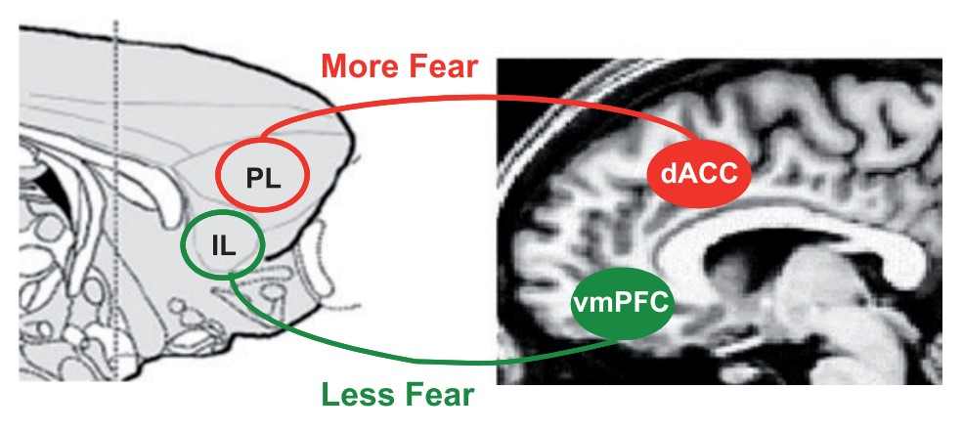
Dual role of PFC in conditioning & extinction
In rodents, prelimbic and infralimbic cortices code for associative memories of opposite valence
PL = conditioning
IL = extinction
Conditioning meta analysis [CS+ > CS-]
BLA neurons projecting to PFC
Extinction learning [CS+E > CS-]
Fullana et al., 2016. Mol. Psychiatry
Senn et al., 2014. Neuron
Milad et al., 2007. Biol. Psychiatry

Slide 6
Research question & prediction
Are associative emotional memories organized the same way in the humans as in rodents?
-Goal-
Identify stable & separable representations of acquisition and extinction across the PFC
vmPFC
dACC
Neural Reinstatement
Acquisition
Extinction
Acquisition
Extinction
Notes:
This leads us to our specific hypothesis – due to the functional separation in affective processing in the PFC, there will be a double dissociation of emotional memory reinstatement. FULL STOP.
Specifically, we predict that extinction memories are preferentially reinstated in the vmPFC, and conditioning memories are preferentially reinstated in the dACC.
Maybe two slides
Additionally, we considered whether individuals with PTSD display dysregulated reinstatement of emotional memories across these regions.
With more words transition from healthy prediction to PTSD prediction

Slide 7
Research question & prediction
Are associative emotional memories organized the same way in the humans as in rodents?
-Goal-
Identify stable & separable representations of acquisition and extinction across the PFC
Heathy
PTSD
dACC
vmPFC
dACC
vmPFC
?
Neural Reinstatement
Neural Reinstatement
Extinction
Extinction
Extinction
Acquisition
Extinction
Acquisition
Acquisition
Acquisition
Notes:
This leads us to our specific hypothesis – due to the functional separation in affective processing in the PFC, there will be a double dissociation of emotional memory reinstatement. FULL STOP.
Specifically, we predict that extinction memories are preferentially reinstated in the vmPFC, and conditioning memories are preferentially reinstated in the dACC.
Maybe two slides
Additionally, we considered whether individuals with PTSD display dysregulated reinstatement of emotional memories across these regions.
With more words transition from healthy prediction to PTSD prediction

Slide 8
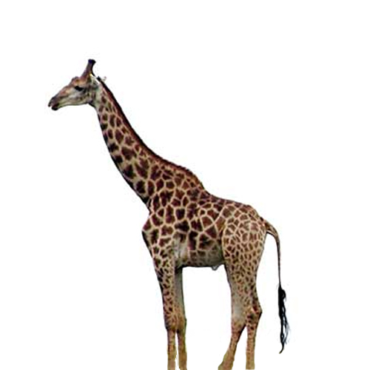









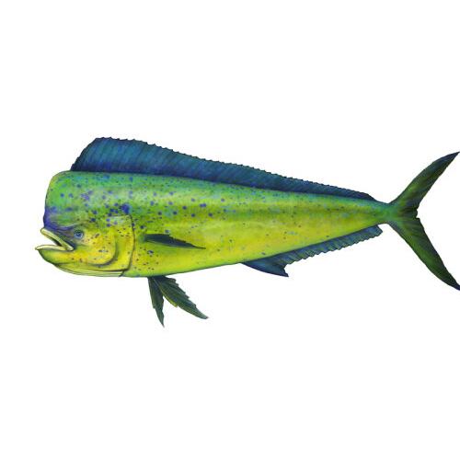


Experimental design
Unlike in rodent models, cannot physically ”tag” neural engrams
Can approximate such a tag using episodic-associative hybrid task
Surprise Recognition
Memory Test
+
+
+
--24hrs--
+
+
+
+
+
Baseline
+
Def Old
Def New
Maybe Old
Maybe New
Animal
or
Tool?
Acquisition 50% CS+US reinforcement
Extinction
Neutral emotional context
CS+
CS-
Notes:
144 old and 96 new foils
Emphasis on novel exemplars – animation?

Slide 9
Analysis
N = 24 Healthy Controls
N = 24 PTSD
Regions of Interest
Encoding Phase
Emotional Valence
Baseline
CS+
Acquisition
CS-
Early Extinction
Extinction
Late Extinction
Notes:
Title needs work “methods/analysis

Slide 10
Measuring encoding retrieval similarity
Encoding
-24hrs-
Retrieval
Baseline
Baseline
Acquisition
Acquisition
Extinction
Extinction
Neural Activity
Low
High

Slide 11
Measuring encoding retrieval similarity
Encoding
Representational Similarity Matrix
-24hrs-
Retrieval
Baseline
Pearson’s r
Baseline
Weak
Strong
Acquisition
Acquisition
Extinction
Extinction
Neural Activity
Low
High

Slide 12

Measuring encoding retrieval similarity
Controls - dACC
Encoding
Fisher Z(correlation)
Retrieval
Encoding
Retrieval
Notes:
Add encoding/retrieval labels to this
Start with EE and RR and then pop out ER

Slide 13
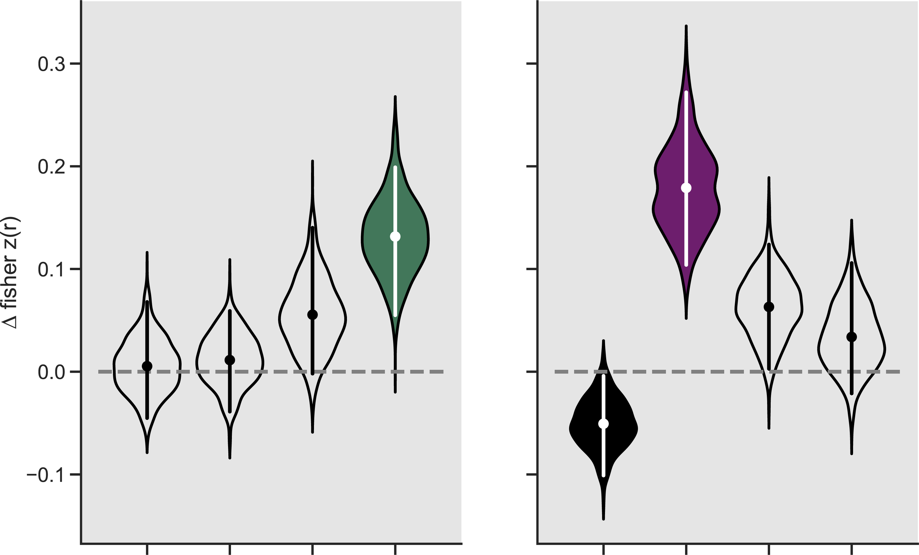
Emotional memory reinstatement
CS+ – CS-
vmPFC
dACC
Baseline
Early
Late
Baseline
Early
Late
Acquisition
Extinction
Acquisition
Extinction
Notes:
“engram like” activity
As we predicted + interpretation
2 slides, BIG pause after controls to let that sink in

Slide 14
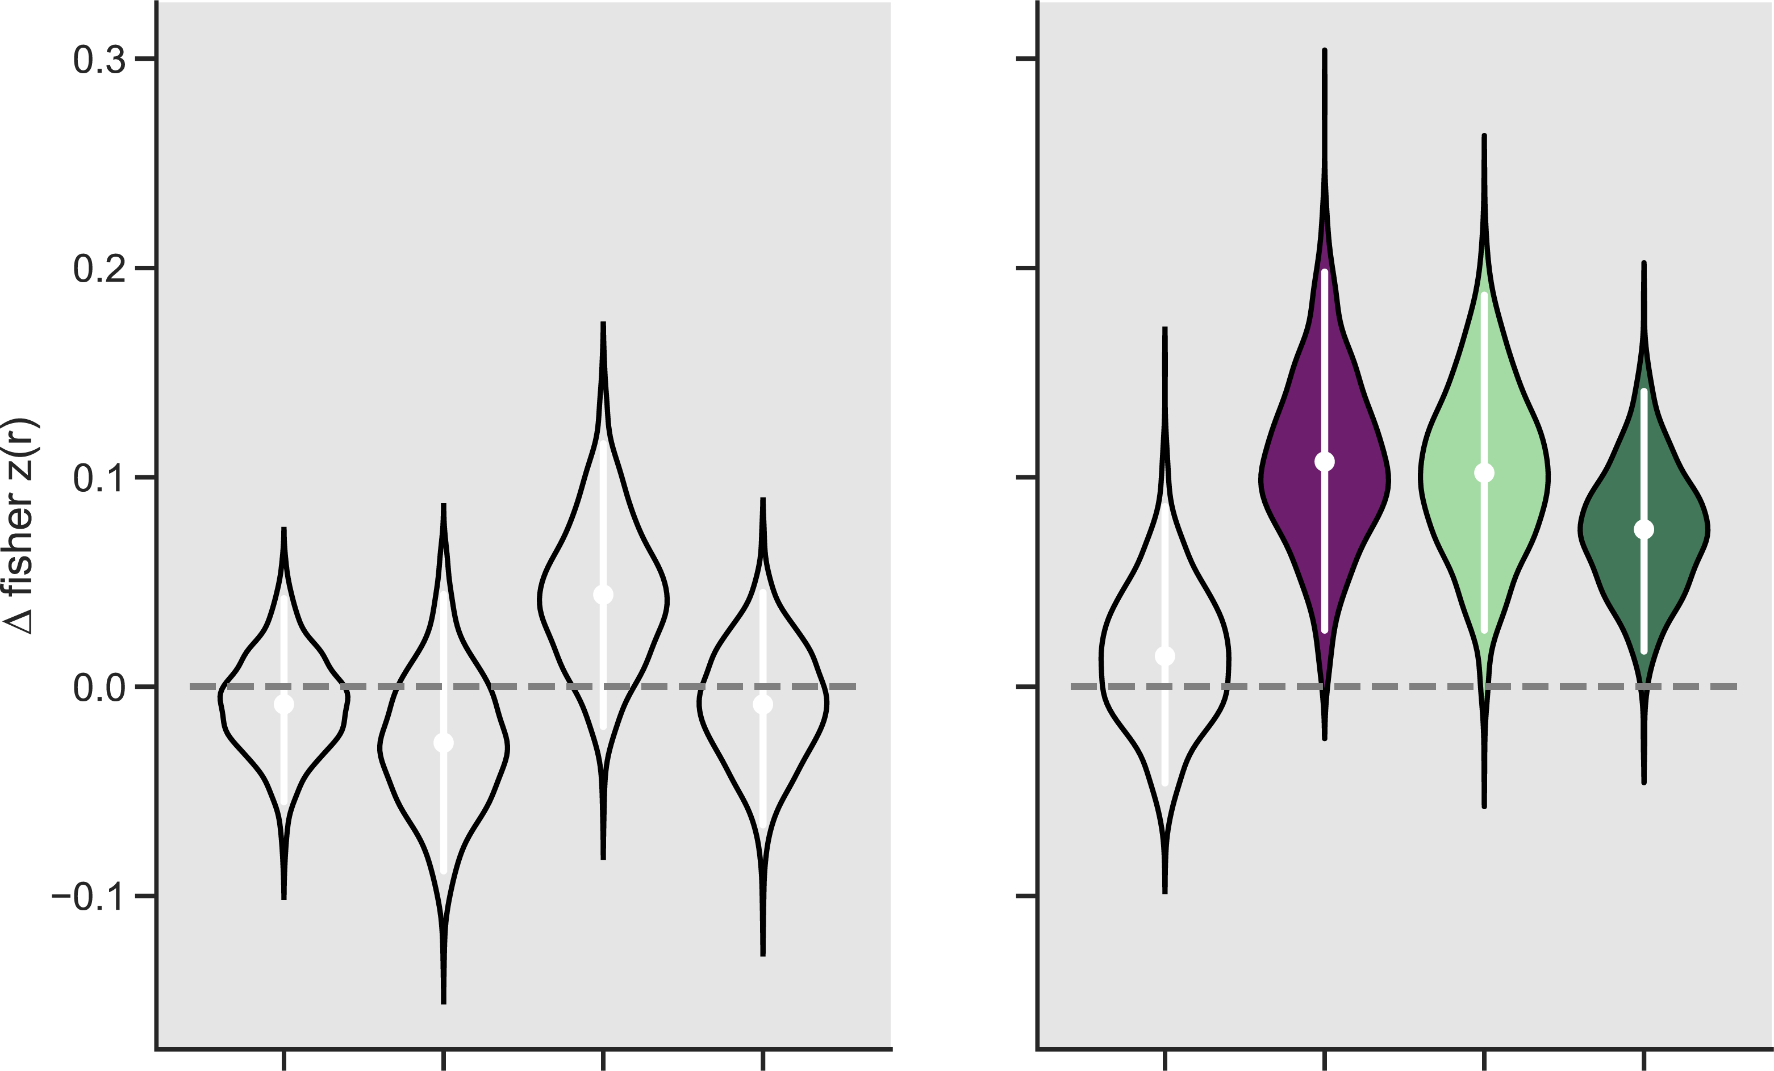
Emotional memory reinstatement
CS+ – CS-
Control
PTSD
vmPFC
dACC
vmPFC
dACC
Early
Late
Early
Late
Baseline
Baseline
Baseline
Early
Late
Early
Late
Acquisition
Acquisition
Baseline
Acquisition
Acquisition
Extinction
Extinction
Extinction
Extinction
Notes:
“engram like” activity
As we predicted + interpretation
2 slides, BIG pause after controls to let that sink in

Slide 15
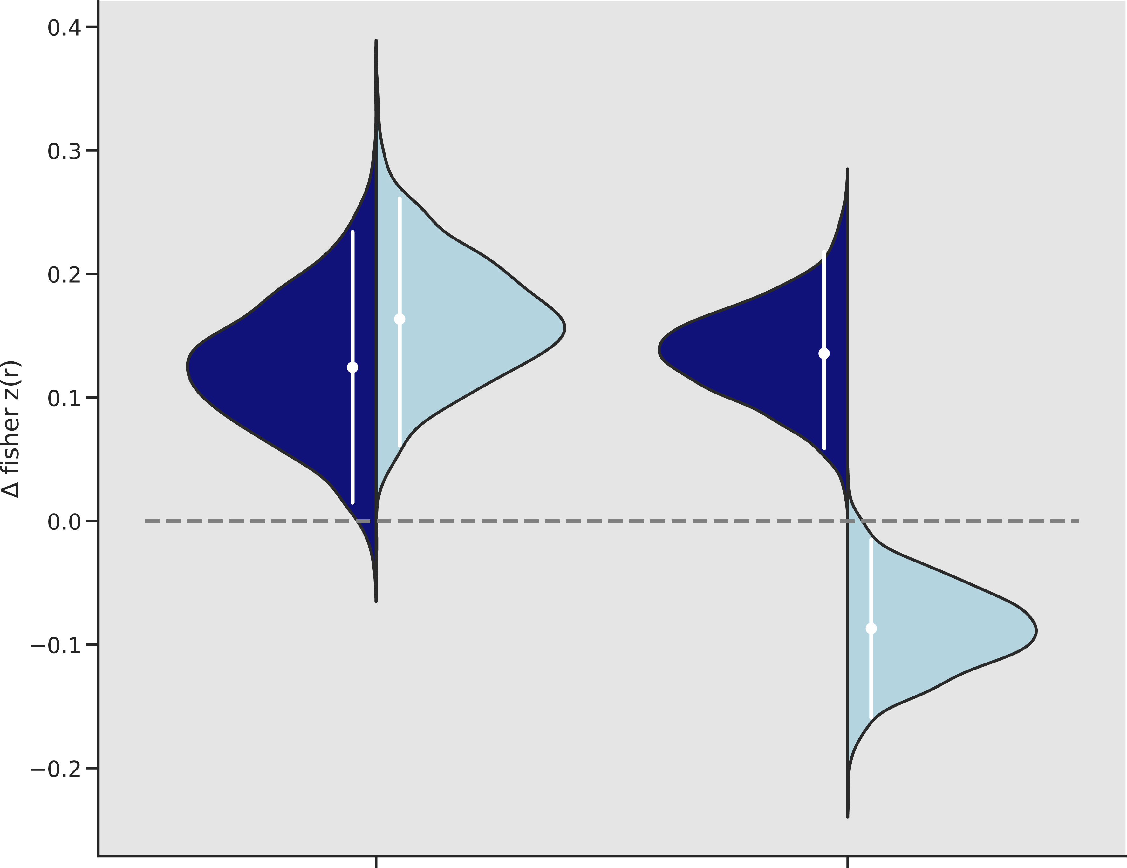
Influence of episodic memory
vmPFC - Late Extinction
Recognition Memory
HIT
MISS
Control
PTSD

Slide 16
Summary
vmPFC
dACC
Dissociable reinstatement in PFC of emotional memories in healthy adults
Individuals with PTSD misallocate extinction memories to dACC
Episodic memory does not influence reinstatement in Controls;
however, PTSD cohort shows strong episodic effect
vmPFC
dACC
vmPFC - Late Extinction
Notes:
This pattern was not observed in PTSD individuals
dACC shows significant ERS for extinction memories – misallocation

Slide 17
Emotional memory reinstatement
CS+ – CS-
Relative ERS
Control
PTSD
vmPFC
dACC
vmPFC
dACC
Baseline
Early Extinction
Late Extinction
Baseline
Early Extinction
Late Extinction
Baseline
Early Extinction
Late Extinction
Baseline
Early Extinction
Late Extinction
Conditioning
Conditioning
Conditioning
Conditioning
Notes:
As we predicted + interpretation
2 slides, BIG pause after controls to let that sink in

Slide 18
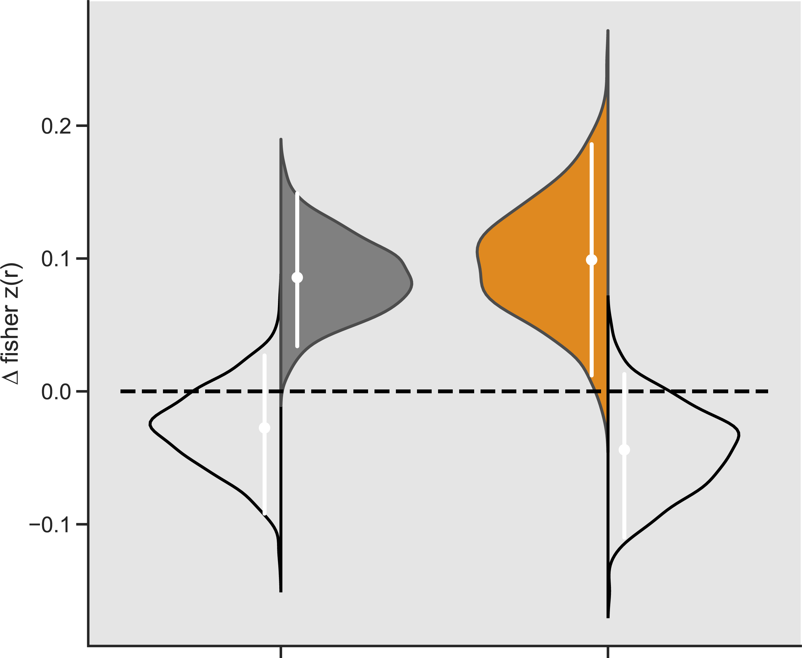
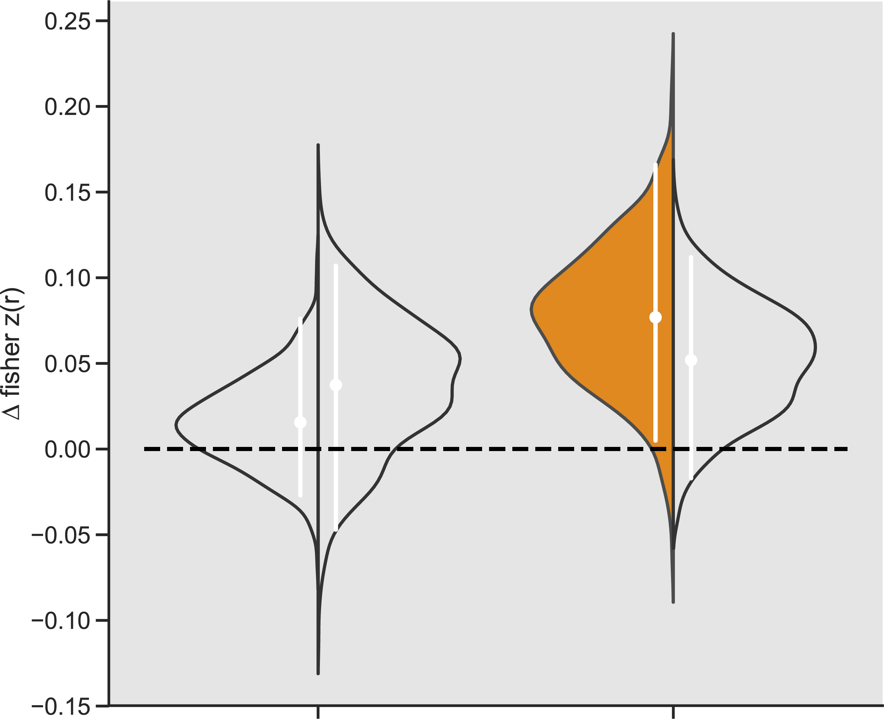
CS+ (left)
Conditioning – Late Extinction
Relative ERS
CS- (right)
Control
PTSD
vmPFC
dACC
vmPFC
dACC
Notes:
Bye bye

Slide 19
Acknowledgements
Dunsmoor Lab
Lewis-Peacock Lab
Joey Dunsmoor, Ph.D.
Emily Leiker, Ph.D.
Sam Cooper, Ph.D.
Carola Salvi, Ph.D.
Augustin Hennings
Nicole Keller
Ayesha Nadiadwala
Mason McClay
Carly Hatchell
Jarrod Lewis-Peacock, Ph.D.
Elizabeth Lorenc, Ph.D.
Ethan Oblak, Ph.D.
Hyojeong Kim
Seth Koslov
Remington Mallett
Augustin Hennings
Allison Bruning
Justin Kilmary
Zachary Bretton
Katlyn Hedgpeth
& Many talented undergraduate RAs

Slide 20
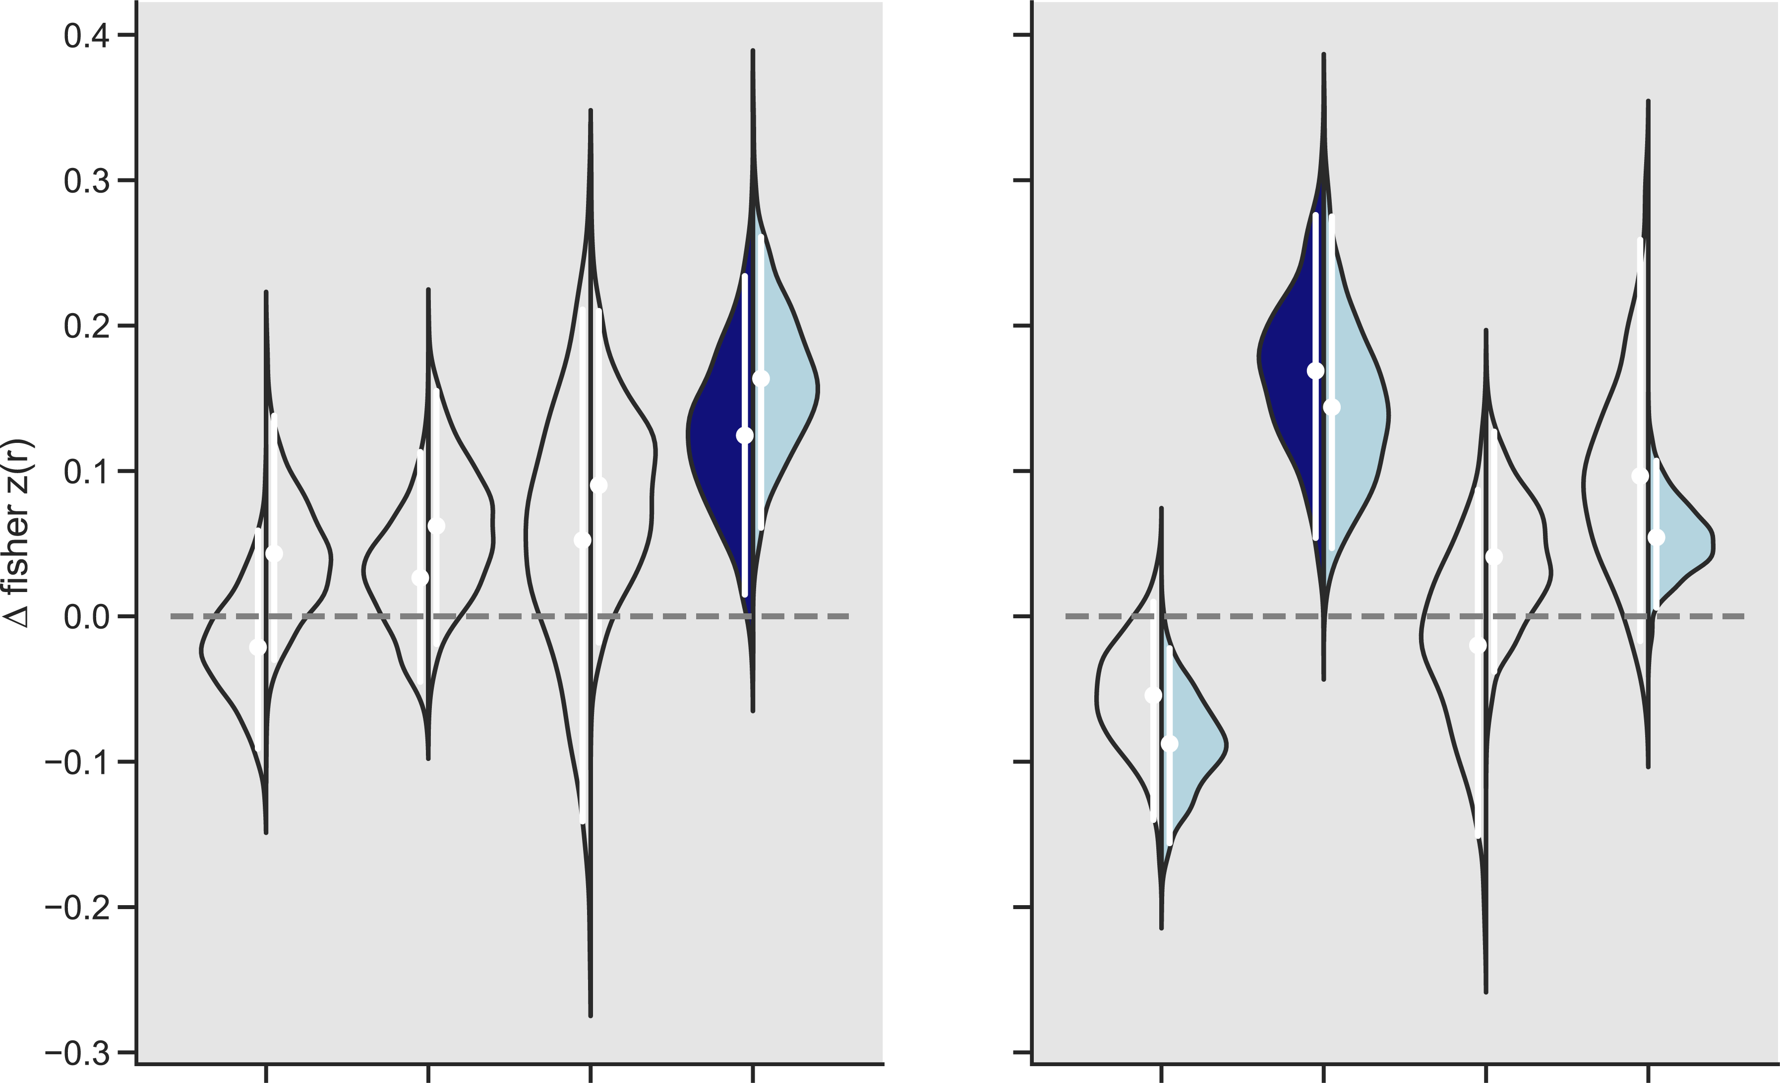
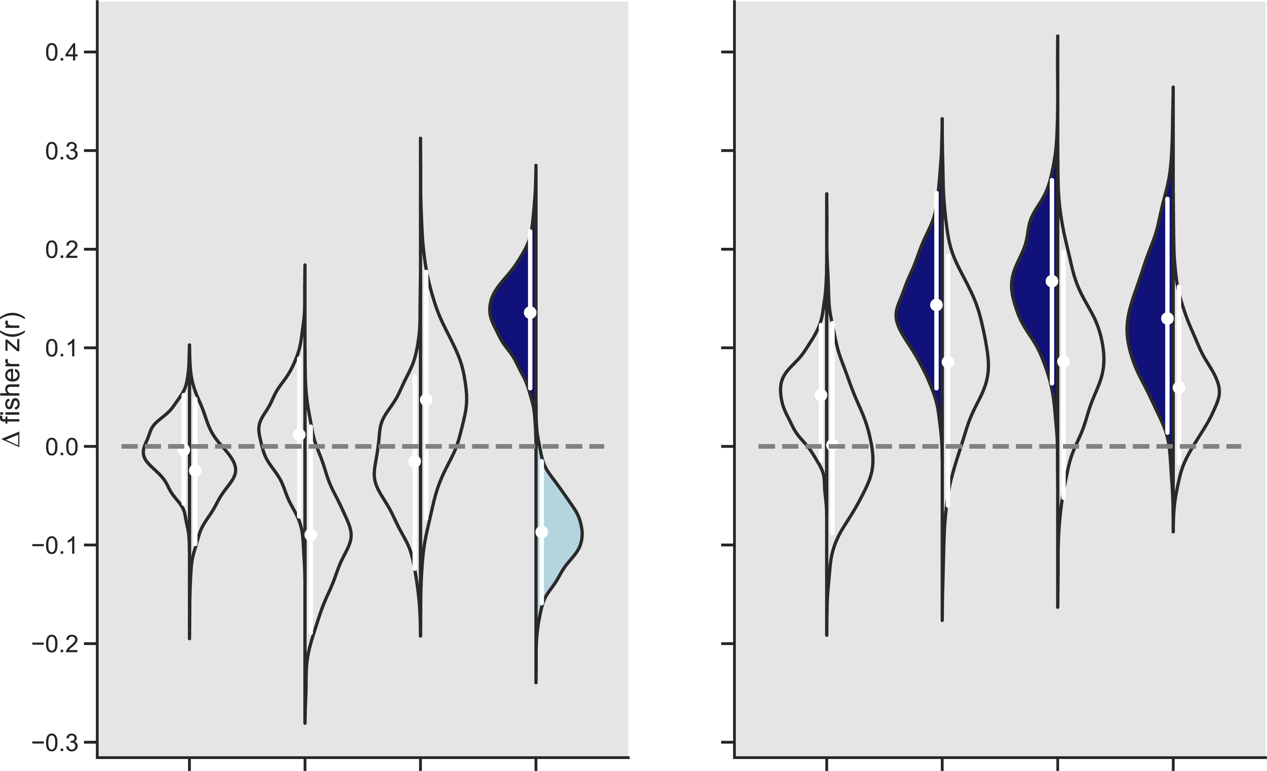
Explicit vs. implicit memory
HIT (left)
CS+ – CS-
Relative ERS
MISS (right)
Control
PTSD
vmPFC
dACC
vmPFC
dACC
Baseline
Early Extinction
Late Extinction
Baseline
Early Extinction
Late Extinction
Baseline
Early Extinction
Late Extinction
Baseline
Early Extinction
Late Extinction
Conditioning
Conditioning
Conditioning
Conditioning

Slide 21
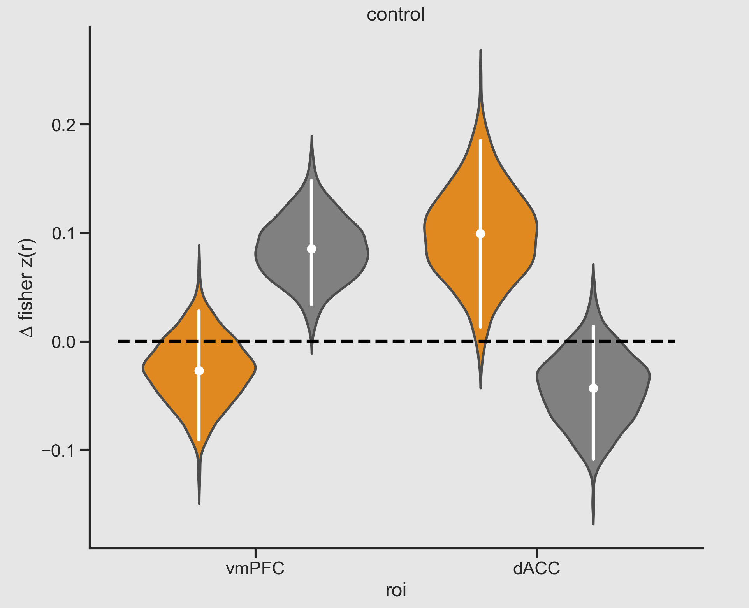
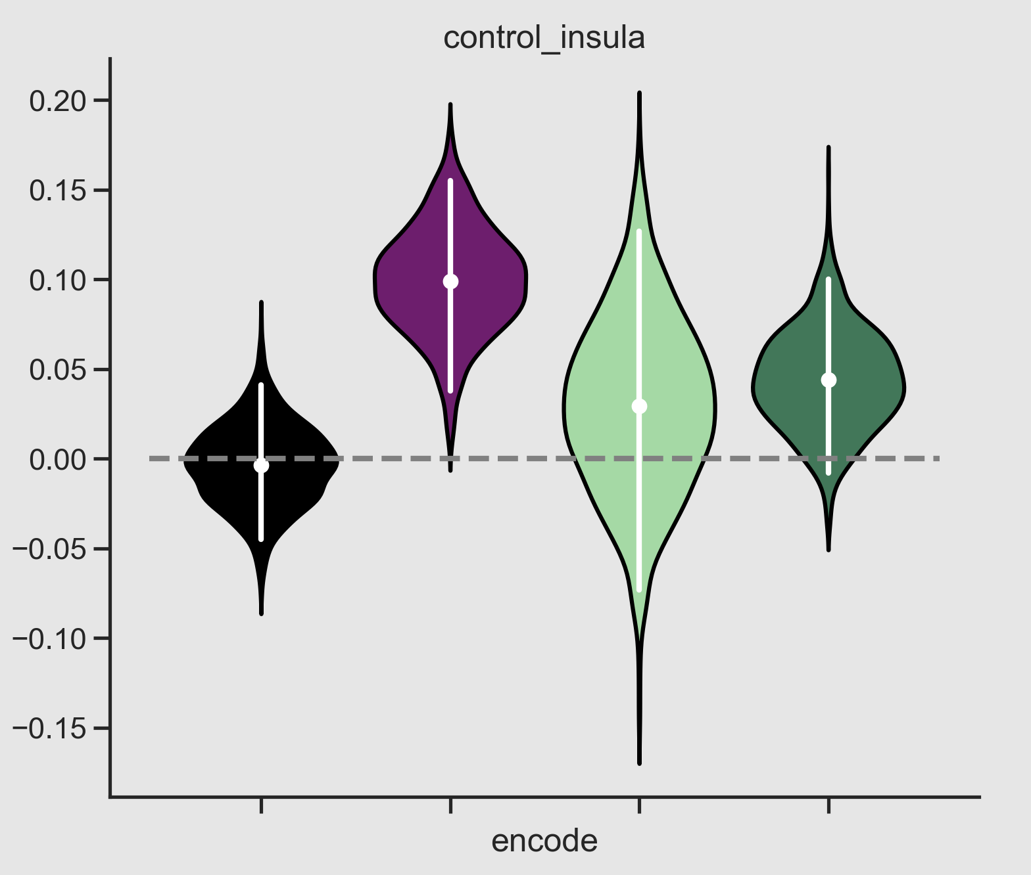
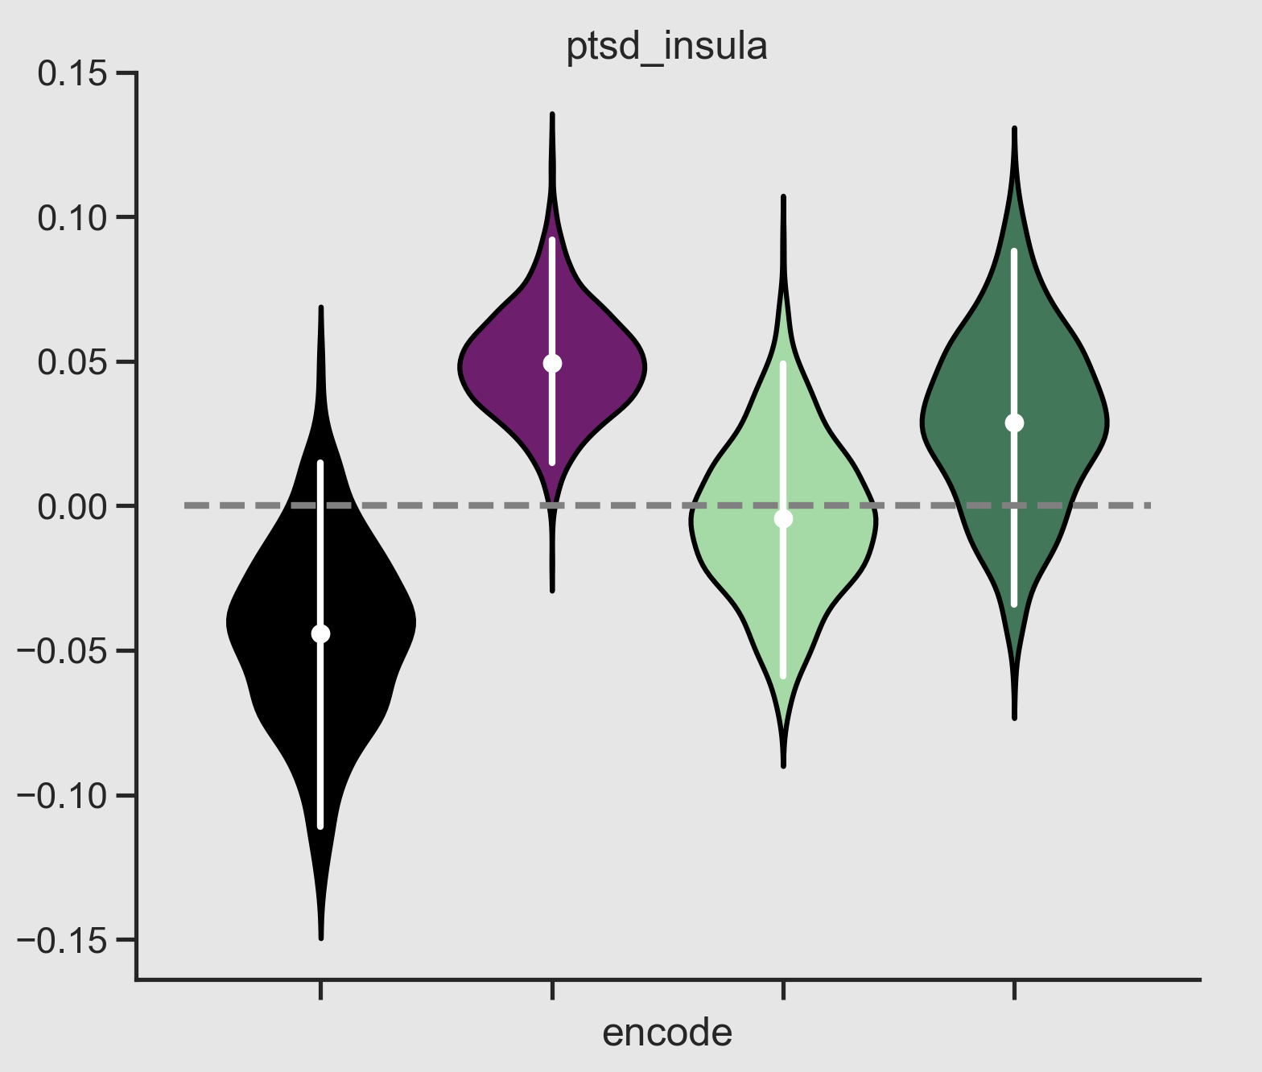
Beyond PFC – Insula
CS+ - CS-
Relative ERS
Control
PTSD
Insula
Insula
Baseline
Early Extinction
Late Extinction
Early Extinction
Late Extinction
Conditioning
Baseline
Conditioning

Slide 22
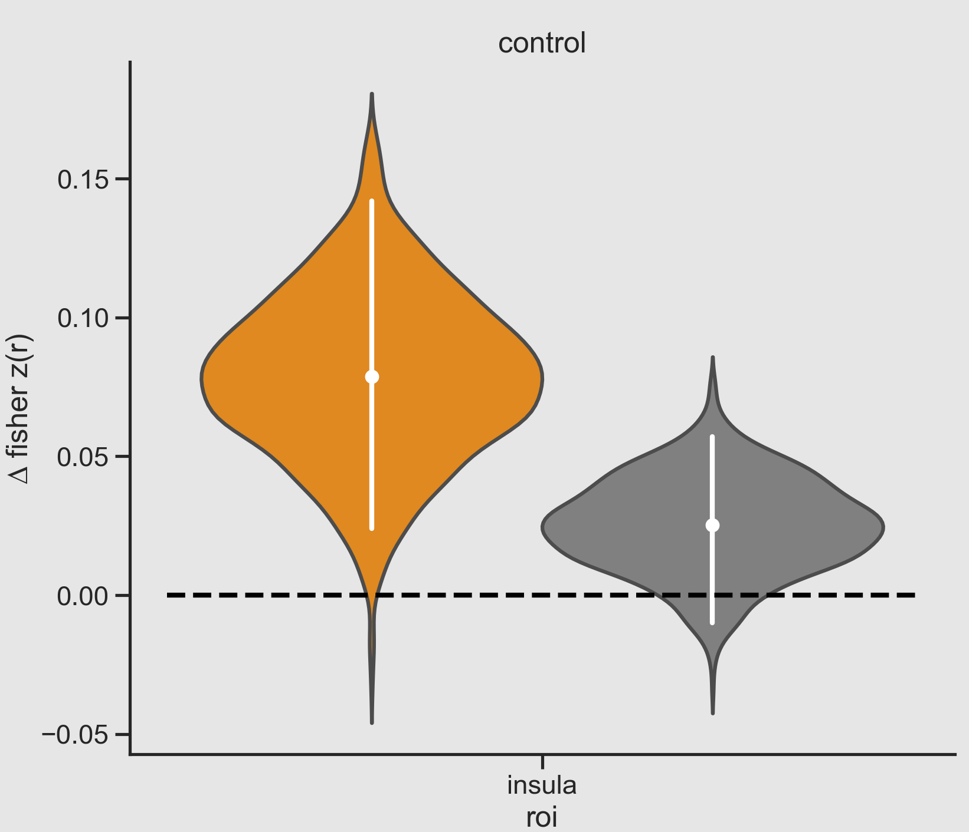
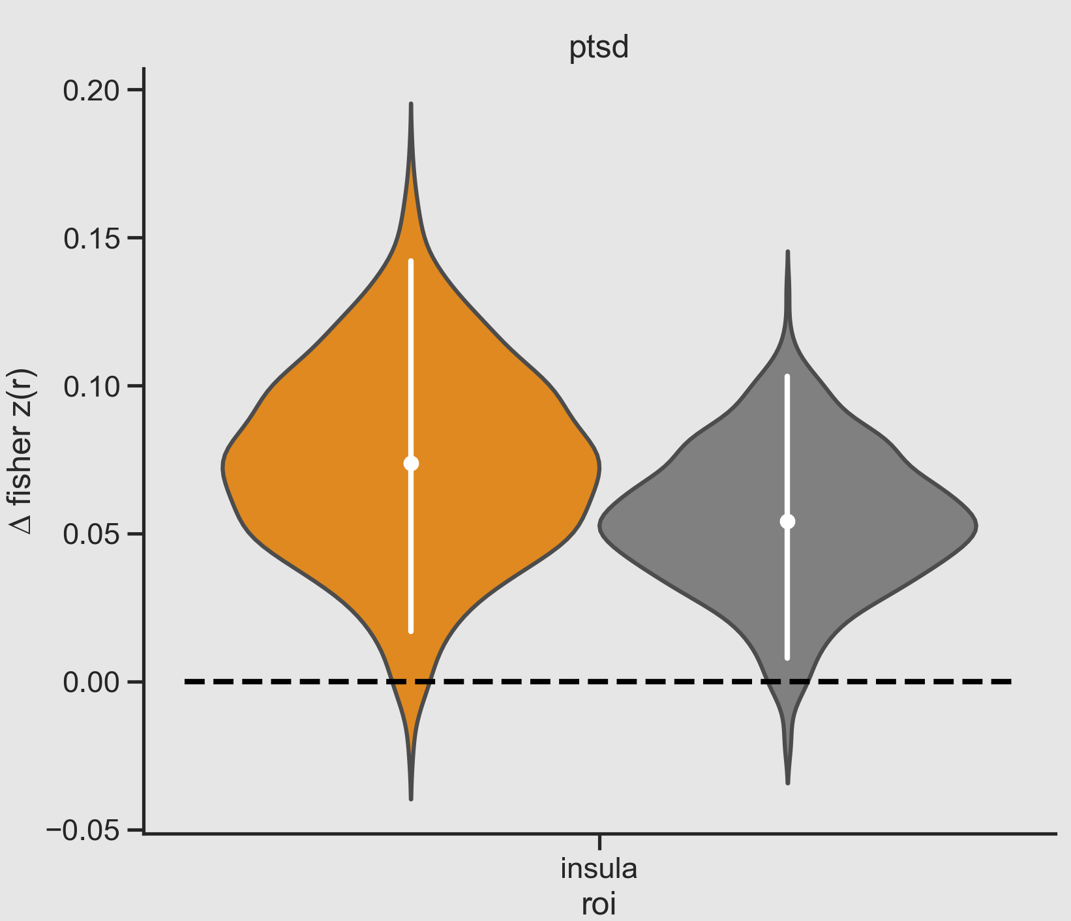
Beyond PFC – Insula
Conditioning – Extinction
Relative ERS
Control
PTSD
CS+
CS-
Insula
Insula

Slide 23
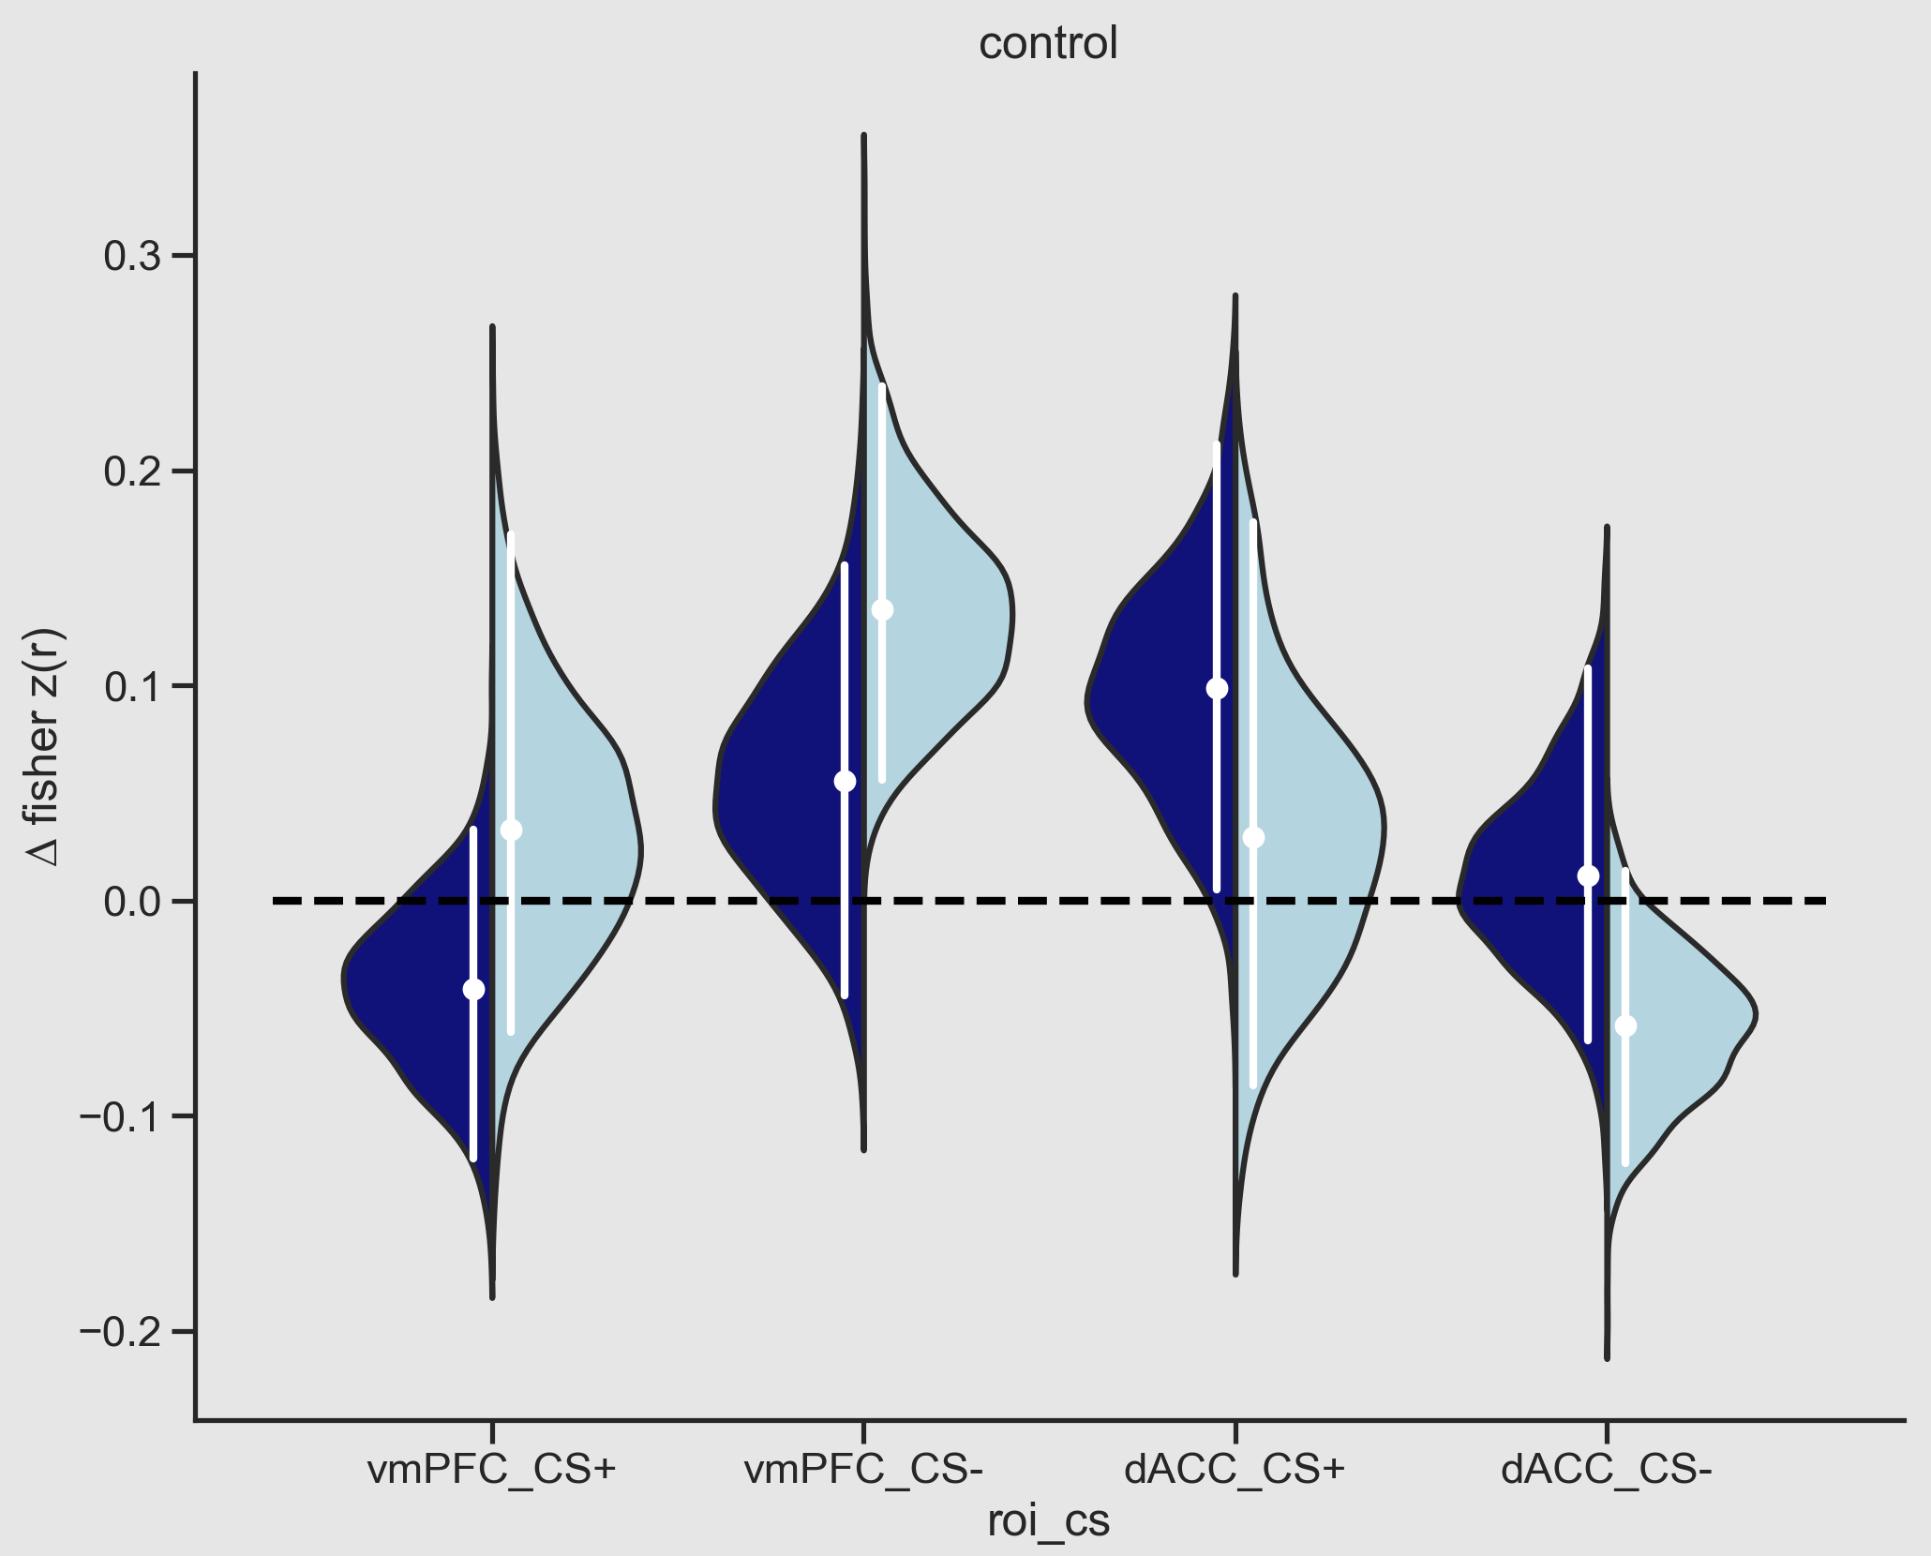
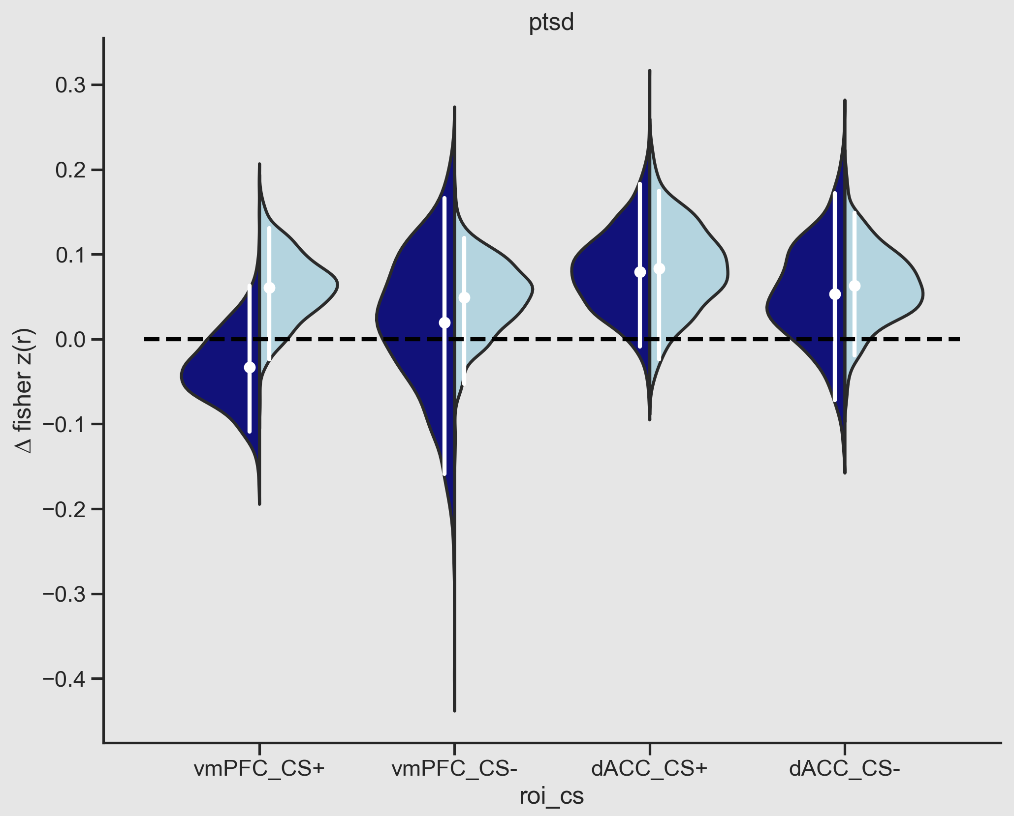
Memory Comparison – Phase Relative
HIT
MISS

Slide 24
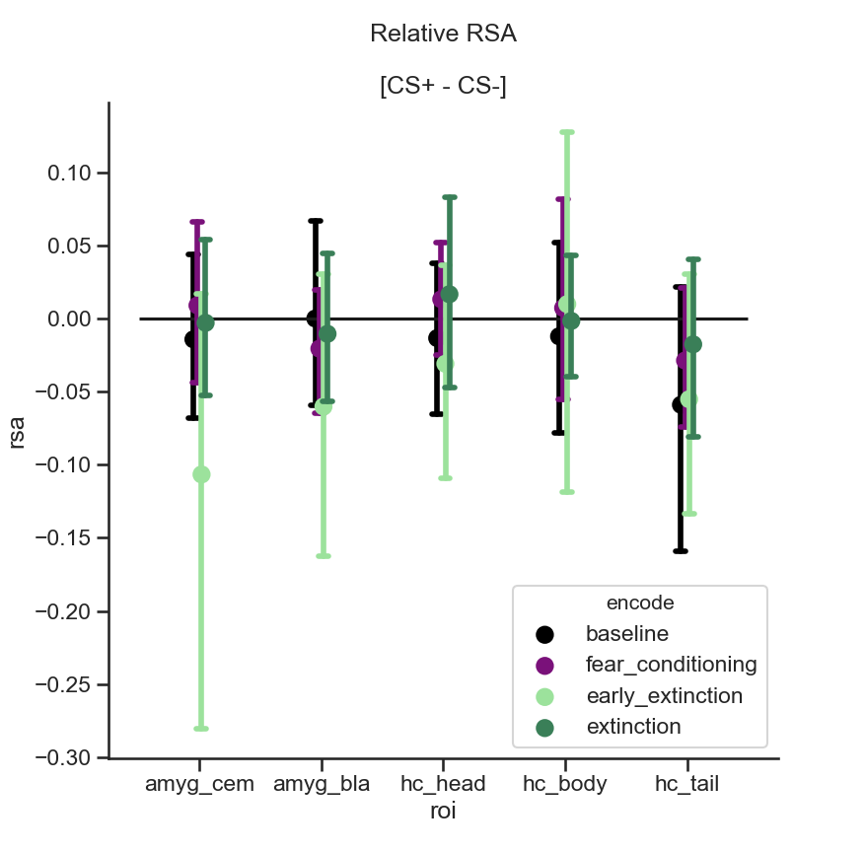
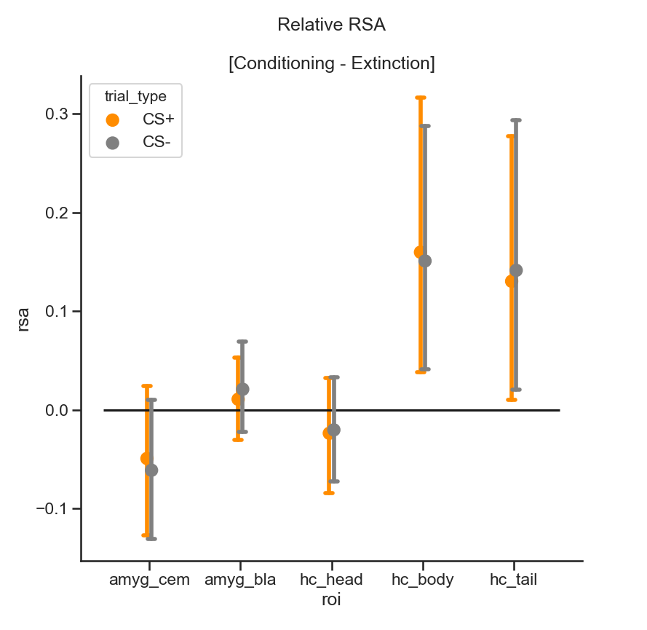
Amygdala & Hippocampal subregions
Controls
Controls

Slide 25
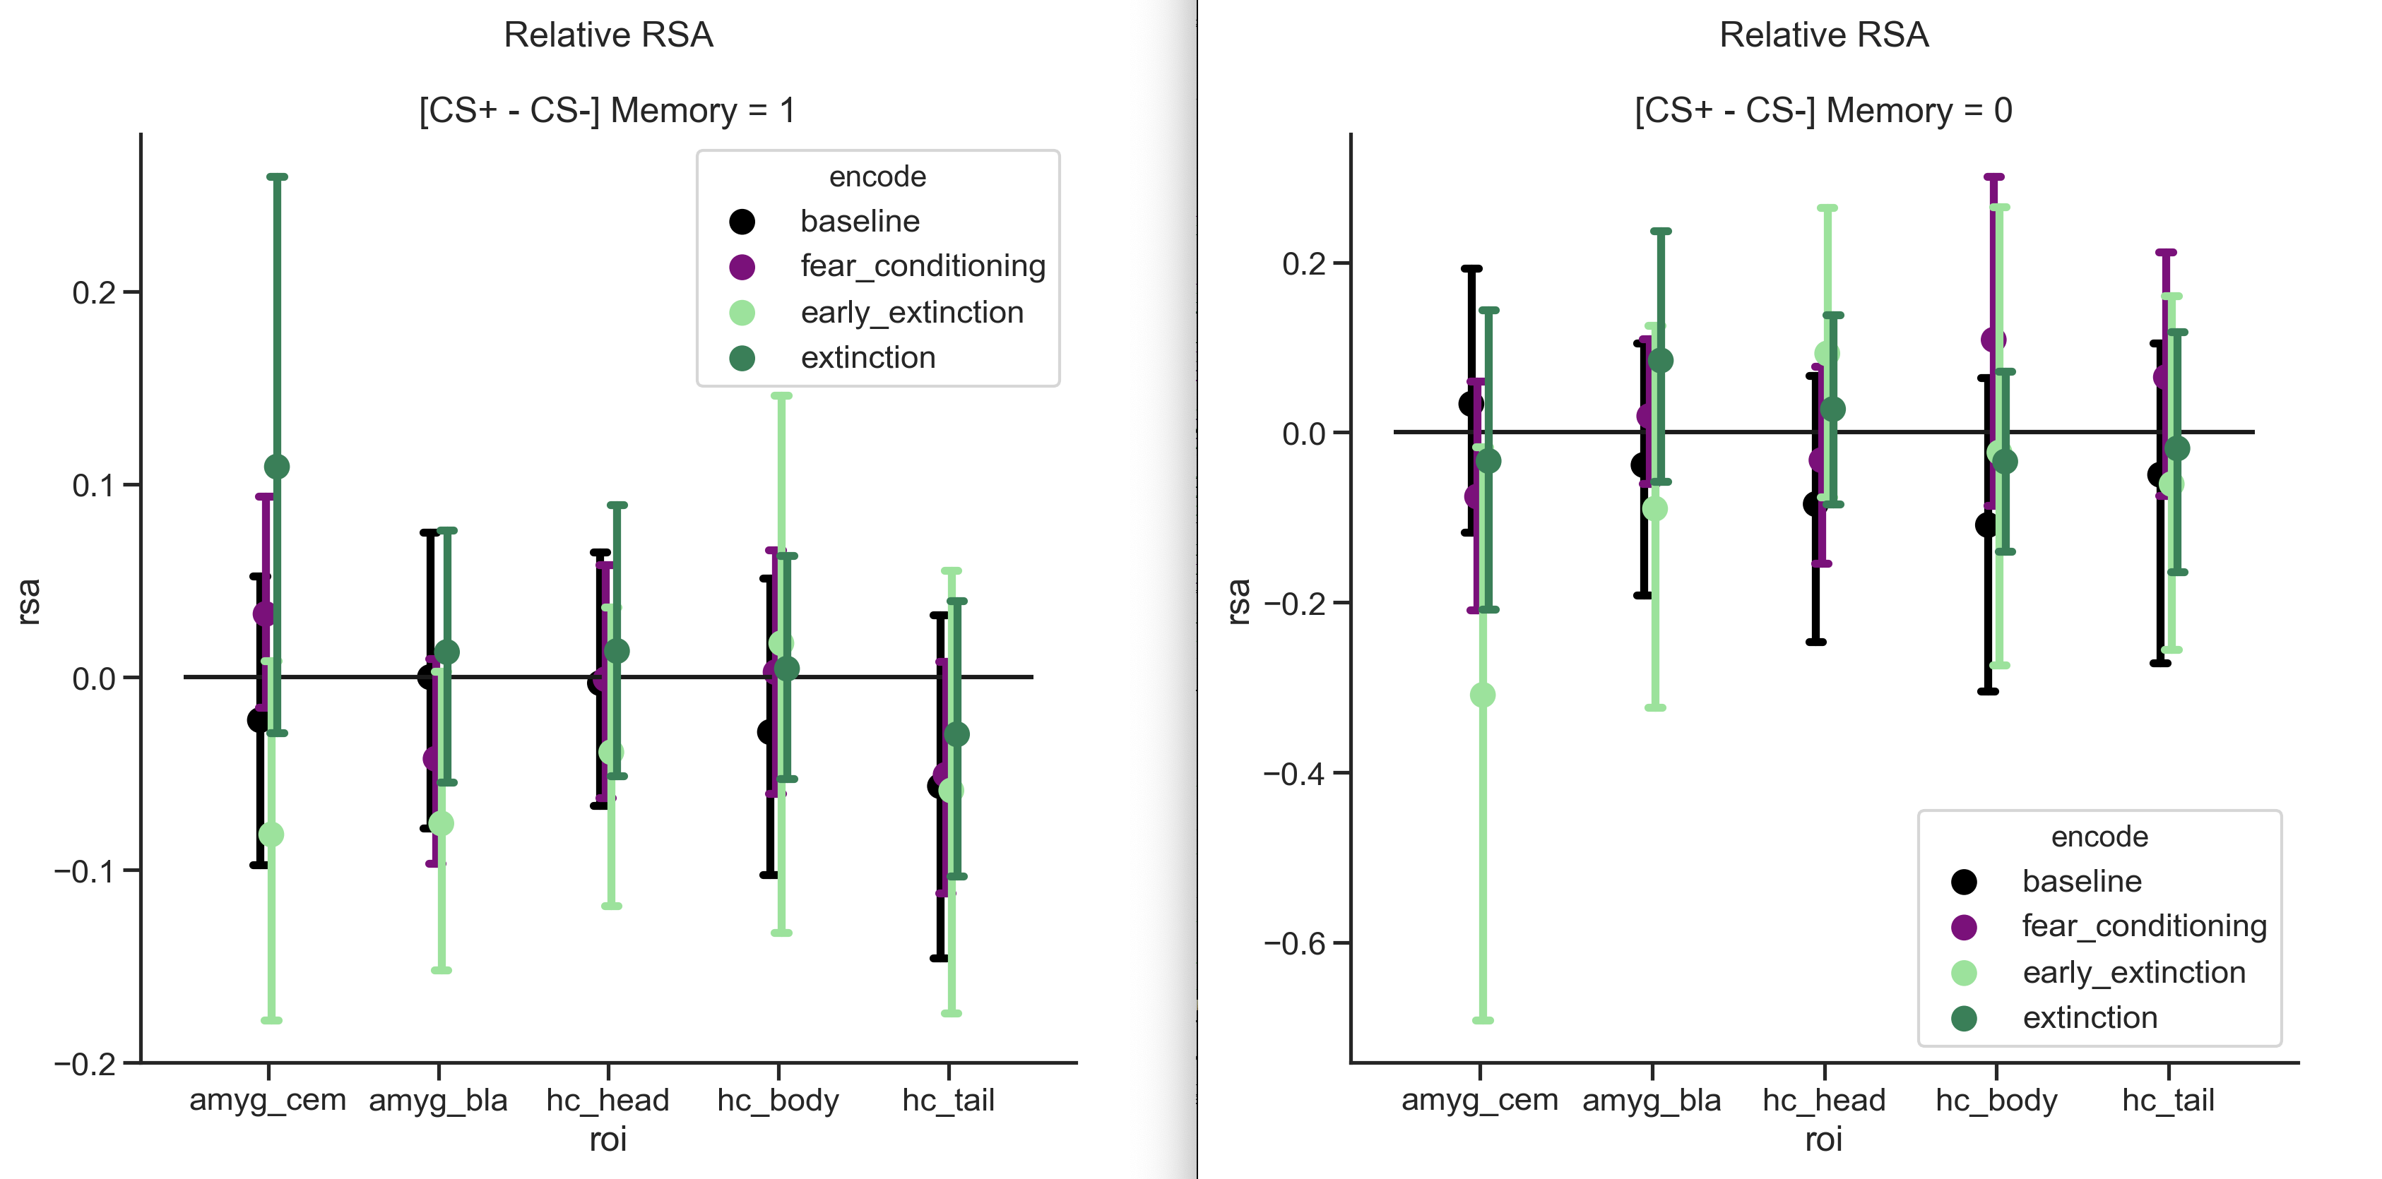
HCA memory comparison - CS

Slide 26
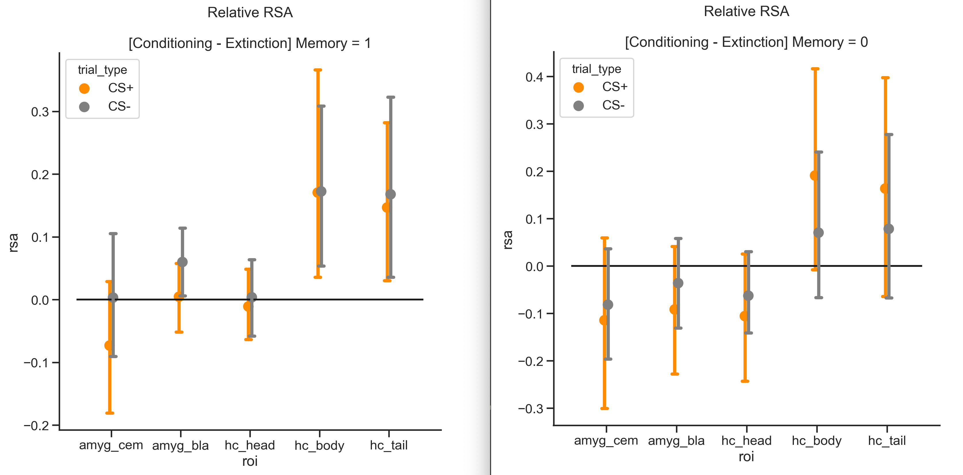
HCA memory comparison - Phase

Slide 27
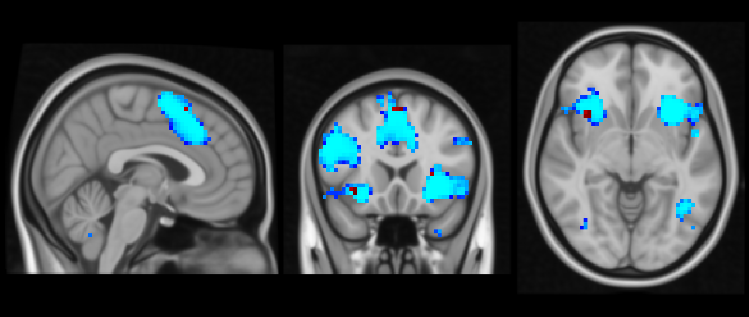
Searchlight approach
Whole brain searchlight, again measuring item level rsa
Radius = 6mm
ANOVA (interaction of Encode Phase X CS type)
p < .001
Controls
PTSD

Slide 28
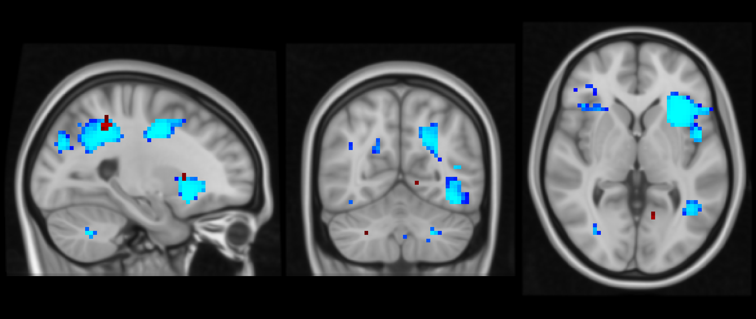
Searchlight cont.
p < .001
Controls
PTSD

Slide 29
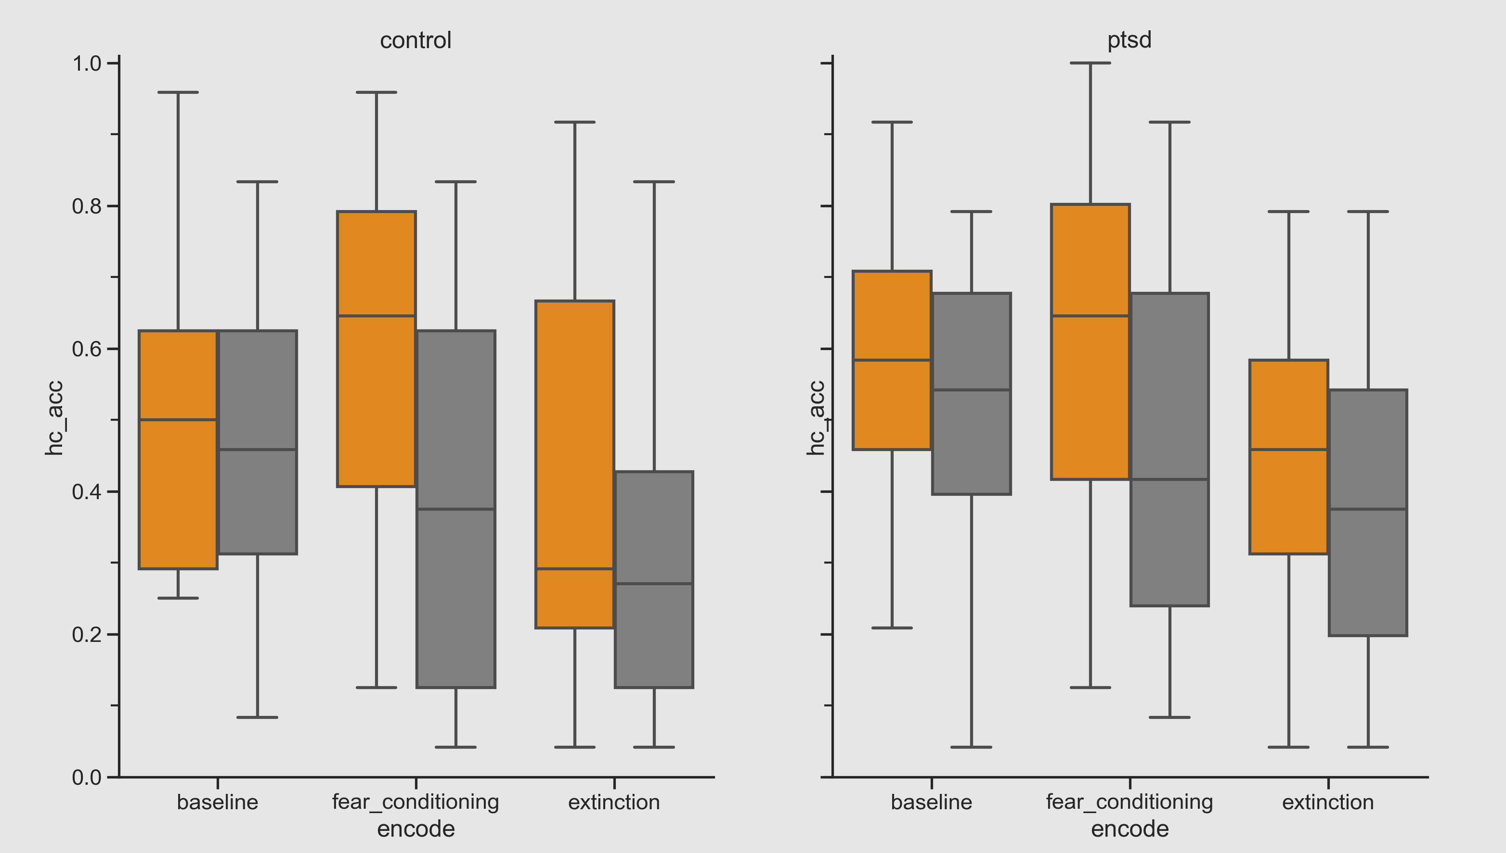
Behavior – Hit Rates
Main effects of encoding phase and CS type
Interaction of encoding phase X CS type

Slide 30
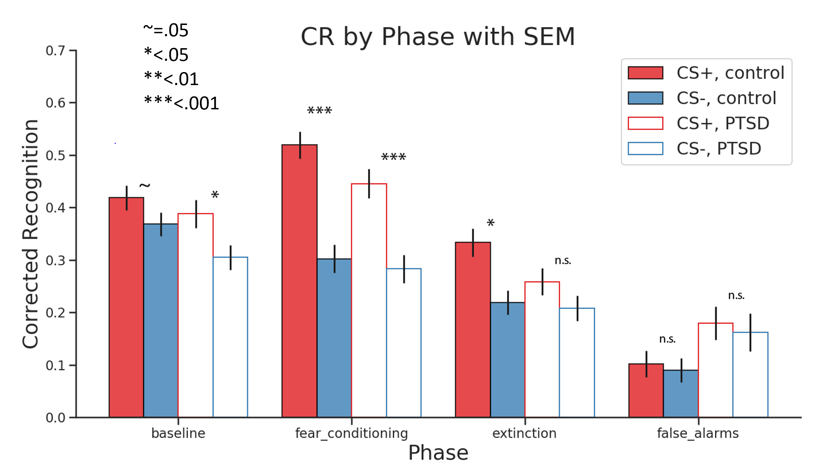
Behavioral Results – Recognition Memory
N = 48 (24 healthy controls, 24 PTSD)
Notes:
No main effect nor interaction of group

Slide 31
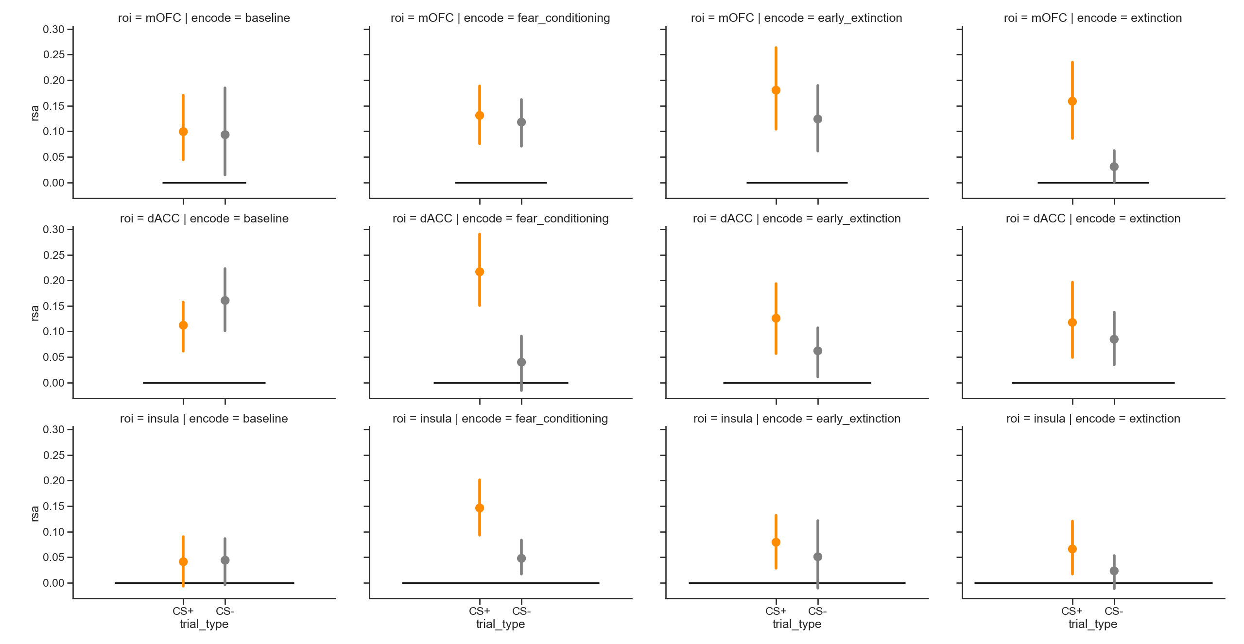
Control raw PFC and insula

Slide 32
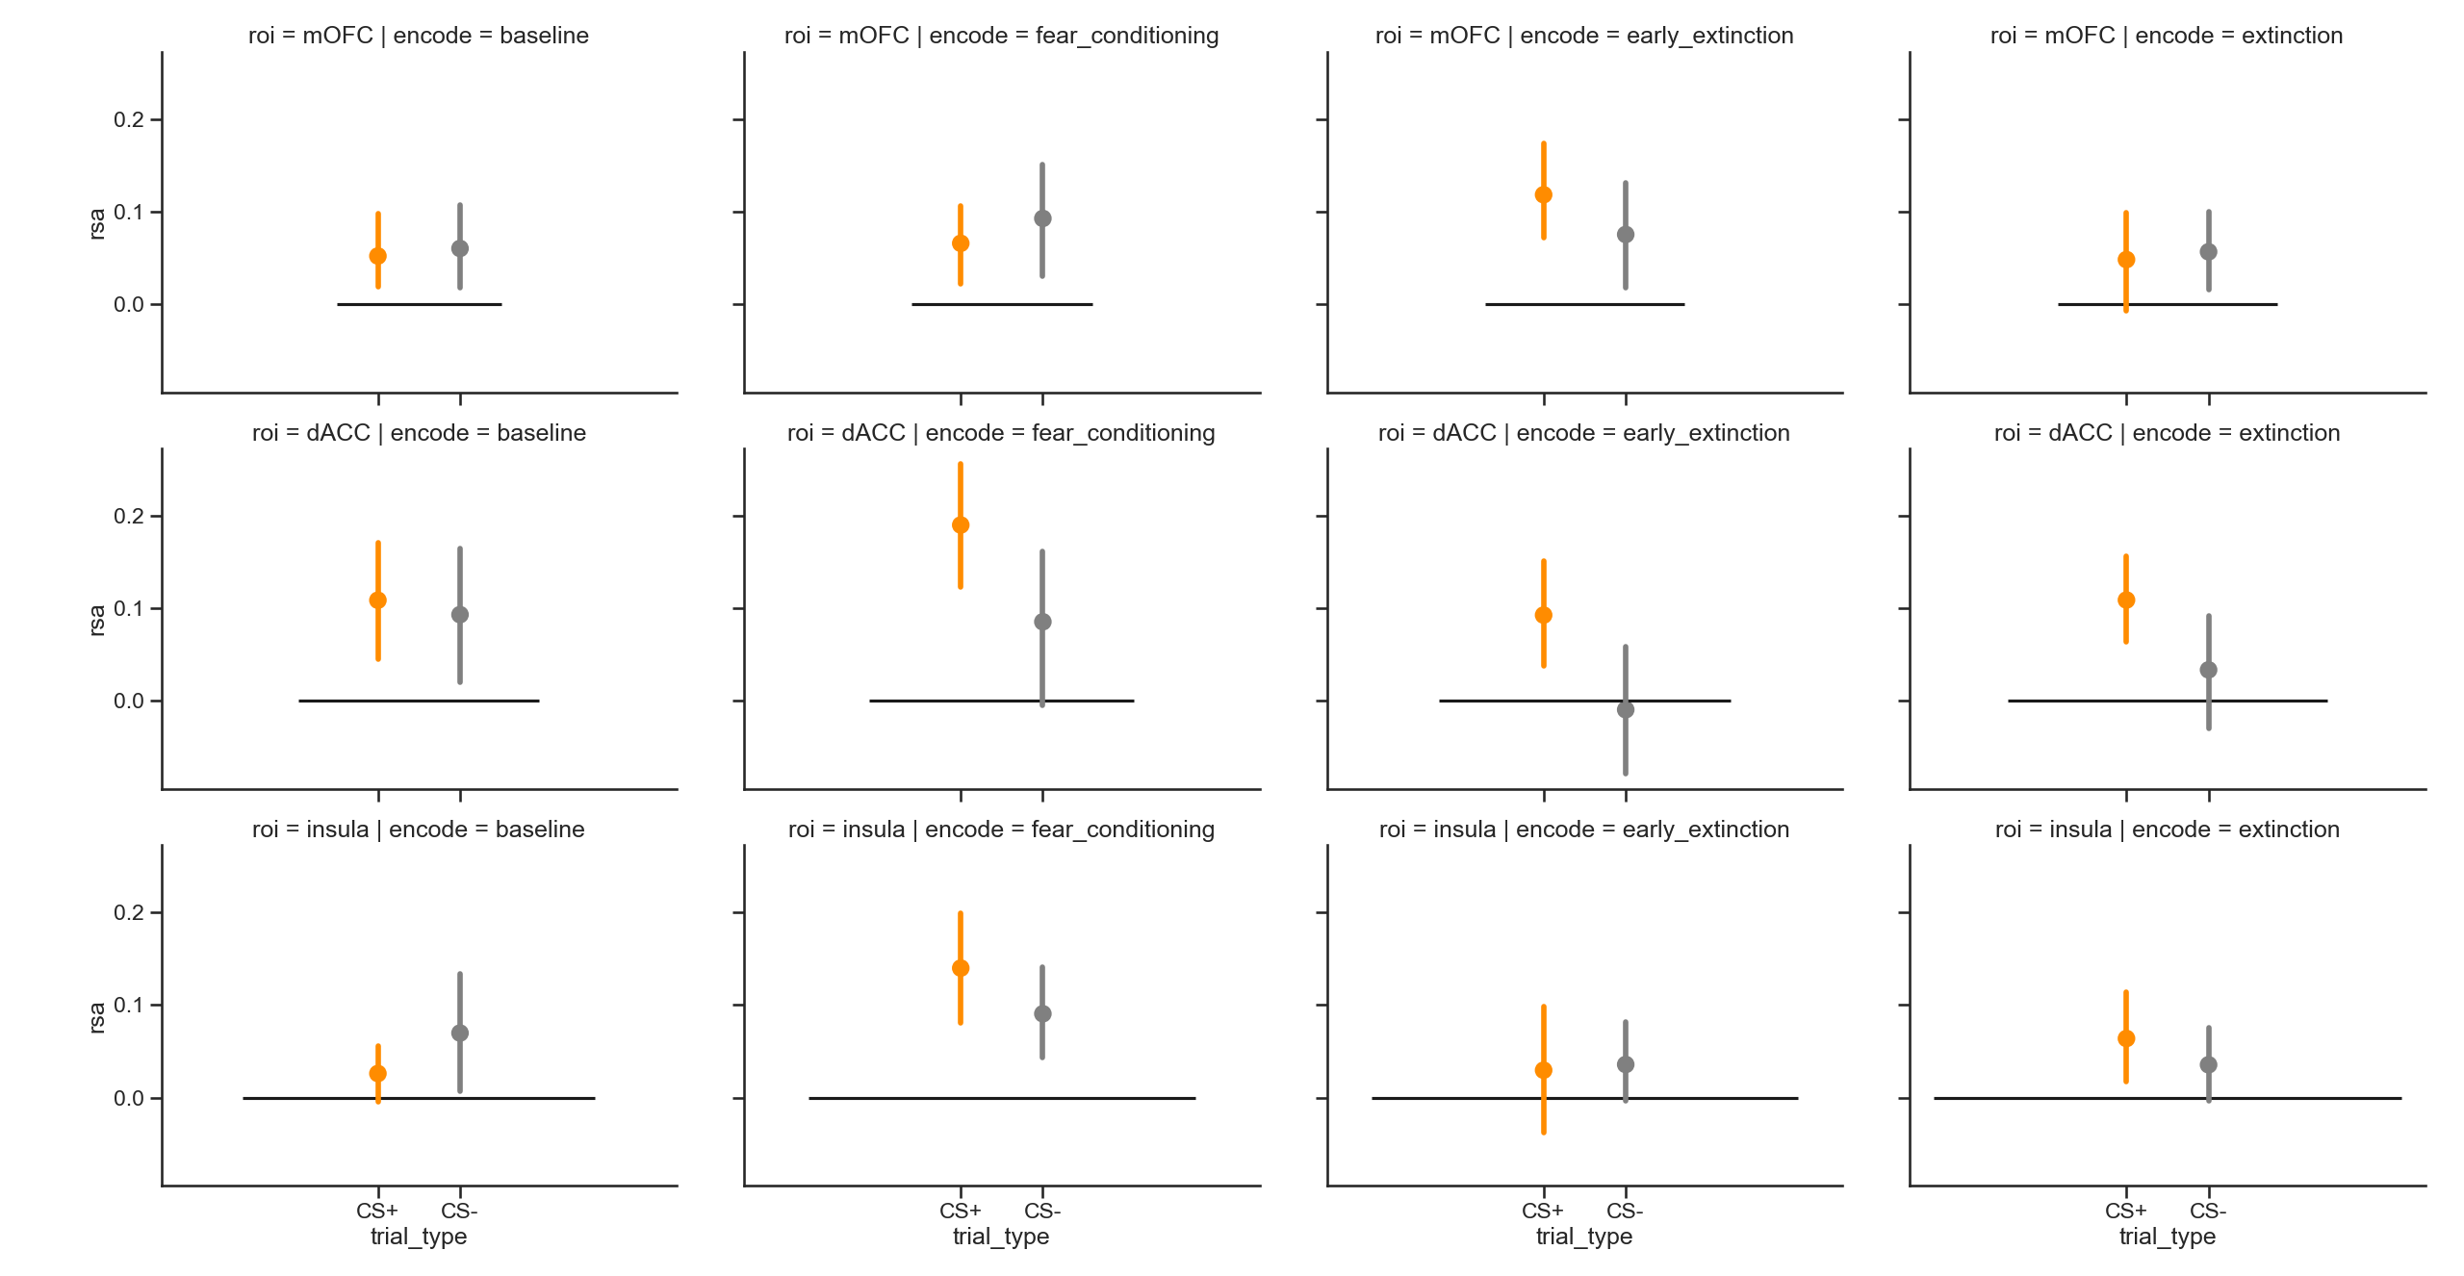
PTSD raw PFC and insula

Slide 33
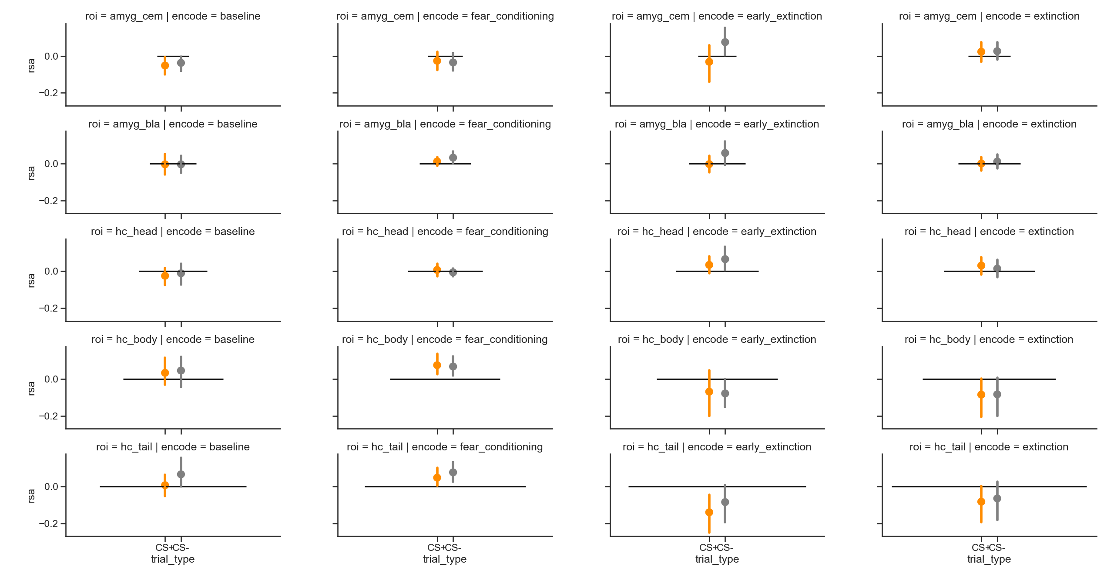
Control HCA raw

